Slide 1
CSE 424 PROJECT IDEA PRESENTATION Human Action recognition using Neural Network

Slide 2
Group 19 Salman Mostafiz Chowdhury – 17101149 S. M. Bayazid Hossain - 16101072 Mohammad Hasin Rahman -17301032 Rizwan Husssain - 1730109

Slide 3
WHAT IS HUMAN ACTION RECONGNITION

Slide 4
Importance of human action recognition

Slide 5
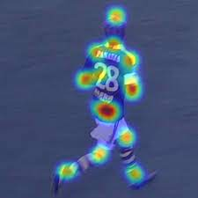
Implementation :
KTH Dataset
Pre trained CNN model with SVM
Comparing RNN with LSTM with Pre Trained CNN model
MOCAP

Slide 6
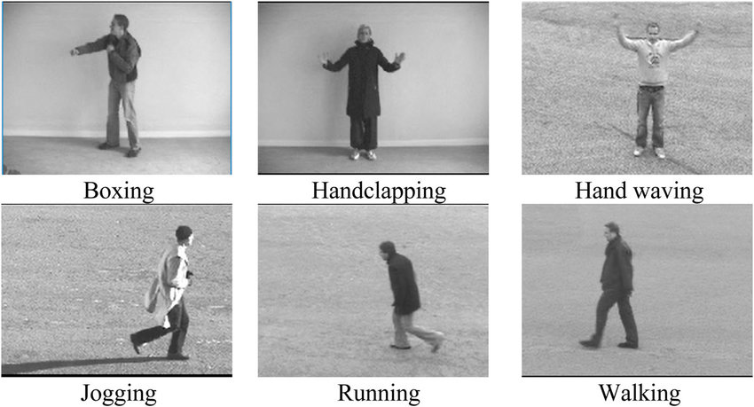

Slide 7
Challenges in Work Flow:
Working with challenging dataset
IXMAS Dataset & UCF-50 dataset
Action & Emotion Recognition

Slide 8
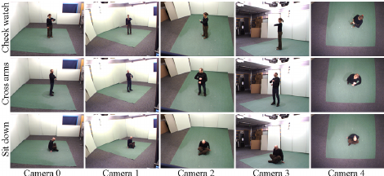

Slide 9
CHALLENGES:
Unlike the conventional artificial feature extraction methods, the deep learning strategies require a large quantity of data to train the network.
Otherwise, it is simple to reason the network to overfit, and the learned features aren't representative, resulting in unsatisfactory action recognition results.
Many datasets cannot offer sufficient data, resulting in inadequate training data.
For the problem of insufficient training data, one viable approach is to enlarge the datasets and increase the quantity of data.
Another viable approach is to apply a pre-training network through transfer learning to prevent overfitting.
Data growth can increase successfully the statistics.
Common data growth strategies have flip, rotation, scale transformation, random picking, color dithering, and Gaussian noise.
The transfer learning normally makes use of a predecessors trained action recognition network as a feature extractor to extract features or immediately train new data with a predecessors trained action recognition method, and fine-tuning the network.
Scalability of calculations, non-convex optimization, disentangling underlying factors of variation, and lack of appropriate representation learning measure.
Moreover, there are a few different challenges inclusive of the need for a professional to design the proper network due to a couple of hyper parameters, modelling numerous elements of versions and the interactions among them, big quantity of local minima, overall performance of Stochastic Gradient Descent (SGD) in lots of layers, over-fitting problem, and the want for a terrific deal of data.

Slide 10


Results
RESULTS WITH DATA BALANCING AND AUGMENTATION
RESULTS OF DIFFERENT HOP SIZES
RESULTS OF DIFFERENT EMBEDDING DIMENSIONS
RESULTS OF PARTIAL TRAINING DATA
RESULTS OF DIFFERENT SAMPLE RATES
RESULTS OF DIFFERENT MEL BINS
RESULTS OF DIFFERENT SYSTEMS

Slide 11
Discussion
We can use PANNs as a pretrained model for new audio pattern recognition tasks.
PANNs have been successful in generalizing to other audio pattern recognition tasks with limited number of training data.

Slide 12
Conclusion
We can use PANNs as a pretrained model for new audio pattern recognition tasks.
PANNs have been successful in generalizing to other audio pattern recognition tasks with limited number of training data.

Slide 13
THANK YOU

